Slide 1

Final Presentation
Members:
Victoria
Benedict
Saw Wei Han
James Poh Hao
Natthaphon

Slide 2
Table of Contents
01
02
03
Overview of Project
Pipeline
Dashboard
04
05
Pipeline Demonstration
Dashboard Demonstration

Slide 3
Overview of Project
Notes:
Project Overview + Problem statement +Hypothesis that we recommended

Slide 4
Overview of Project
Problem:
Customers are leaving the platform prematurely
Do not log into the application
Which leads to lesser data being collected
Project Goal:
We want to use user behaviour data to identify how the UI/UX can be improved within the mobile platform to help as many customers stay on the application and make payment using the application.
Notes:
To recap, Sicpama’s problem was that customers are leaving the platform prematurely and they do not log into the application. Both of which lead to lesser data being collected.
Hence, our project goal is to use the user behaviour data to identify what user interface can be improved within their platform so that we could help as many customers to stay and make payment using this application.
To introduce SICPAMA, their key selling point is that they attract and retain repeat customers

Slide 5
Hypothesis & Recommendations
Notes:
Project Overview + Problem statement +Hypothesis that we recommended

Slide 6
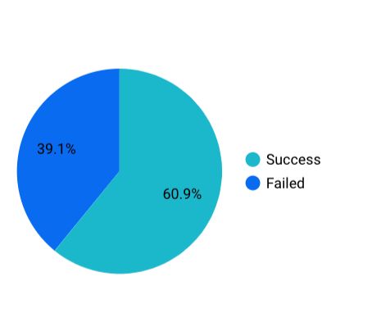
Problem : Significant dropout sessions from ordering application
SessionStatus Pie Chart
We noticed a significant number of failed (39.1%) sessions and wanted to find out the underlying factors for them.

Slide 7
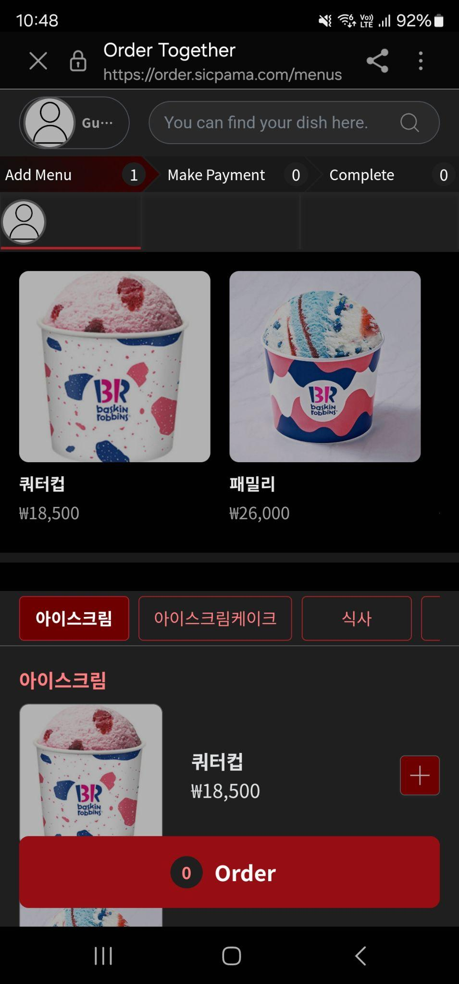
Hypothesis 1 - Excessive scrolling causes drop offs
Significant scrolling to get to certain items
Each item takes up a large portion of space, and hence possibly lead to longer scrolling if menu has many items
May cause customers to lose interest in using application to order and use physical menu instead
Fitts’ law states that the amount of time required for a person to move a pointer to a target area is a function of the distance to the target divided by the size of the target

Slide 8
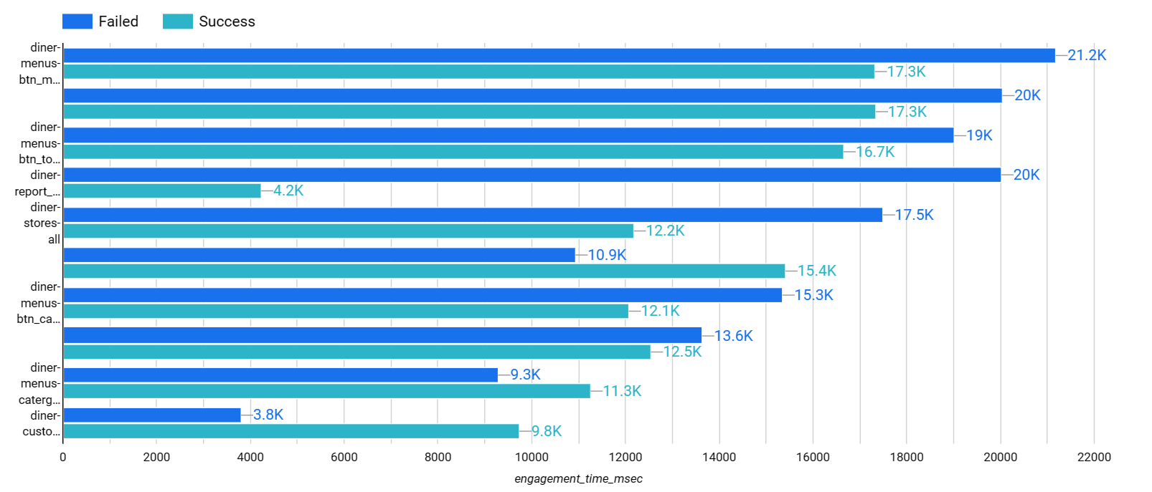
Hypothesis 1 - Excessive scrolling causes drop offs
The average engagement time in milliseconds is generally higher for sessions with failed status than those with success statuses
As such, we theorise that the UI issue of having to scroll too much causes drop offs from the application
-> Recommendation 1

Slide 9
Monetary Value of Time
Slow websites frustrate users, leading to higher bounce rates and decreased time spent on the site. When visitors encounter delays, they are more likely to navigate away, reducing the opportunity for businesses to communicate their value proposition effectively (Seriously Digital, 2023)
A 1 second delay (Wassel, 2021):
Eats away 7% of the coveted conversion rate
Decreases customer satisfaction by 16%
Hypothesis 2 - Longer loading time between pages for failed sessions

Slide 10
Hypothesis 2 : Longer loading time between pages for failed sessions
Crafted the hypothesis :
Null Hypothesis : The average loading time on failed session is less than or equal to the average loading time spent on success session.
Alternate Hypothesis : The average loading time spent on failed session is greater than the average loading time spent on success session
Preprocessed, Sort and Cleaned Initial Dataframe
Feature Generation
Generated 2 other feature columns to help analyze the load time

Slide 11
Hypothesis 2 : Longer loading time between pages for failed sessions
Segregated the data points into 2 groups, success and failed sessions and sampled the lower bounds (~3000++) data points from both groups.
Conduct a simple t-test on the two groups and collected the results
Results showed that our hypothesis is true:
The average loading time spent on failed session is greater than the average loading time spent on success session

Slide 12
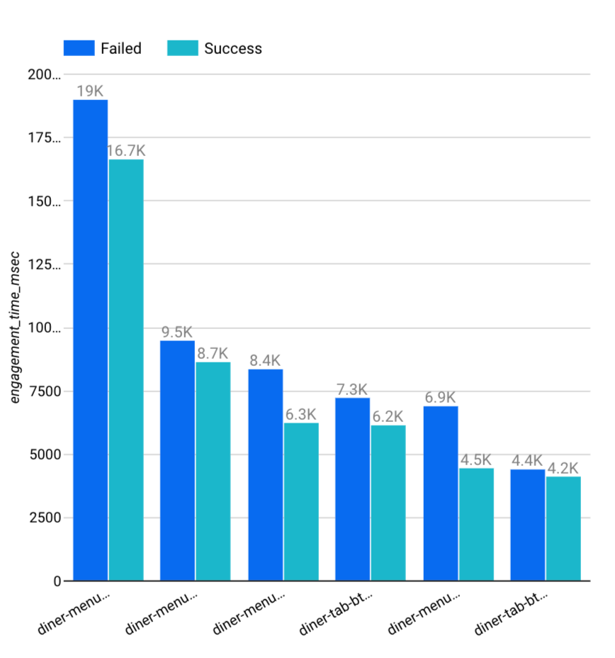
Hypothesis 2 : Longer loading time between pages for failed sessions
To investigate further, we also plot the chart to visualize the difference between the average engagement time between the two session groups.
Discovered that the failed group has a higher average engagement time per msec across all routable buttons compared to the success group.
-> Recommendation 2

Slide 13
Pipeline
Notes:
Moving on to the pipeline.

Slide 14
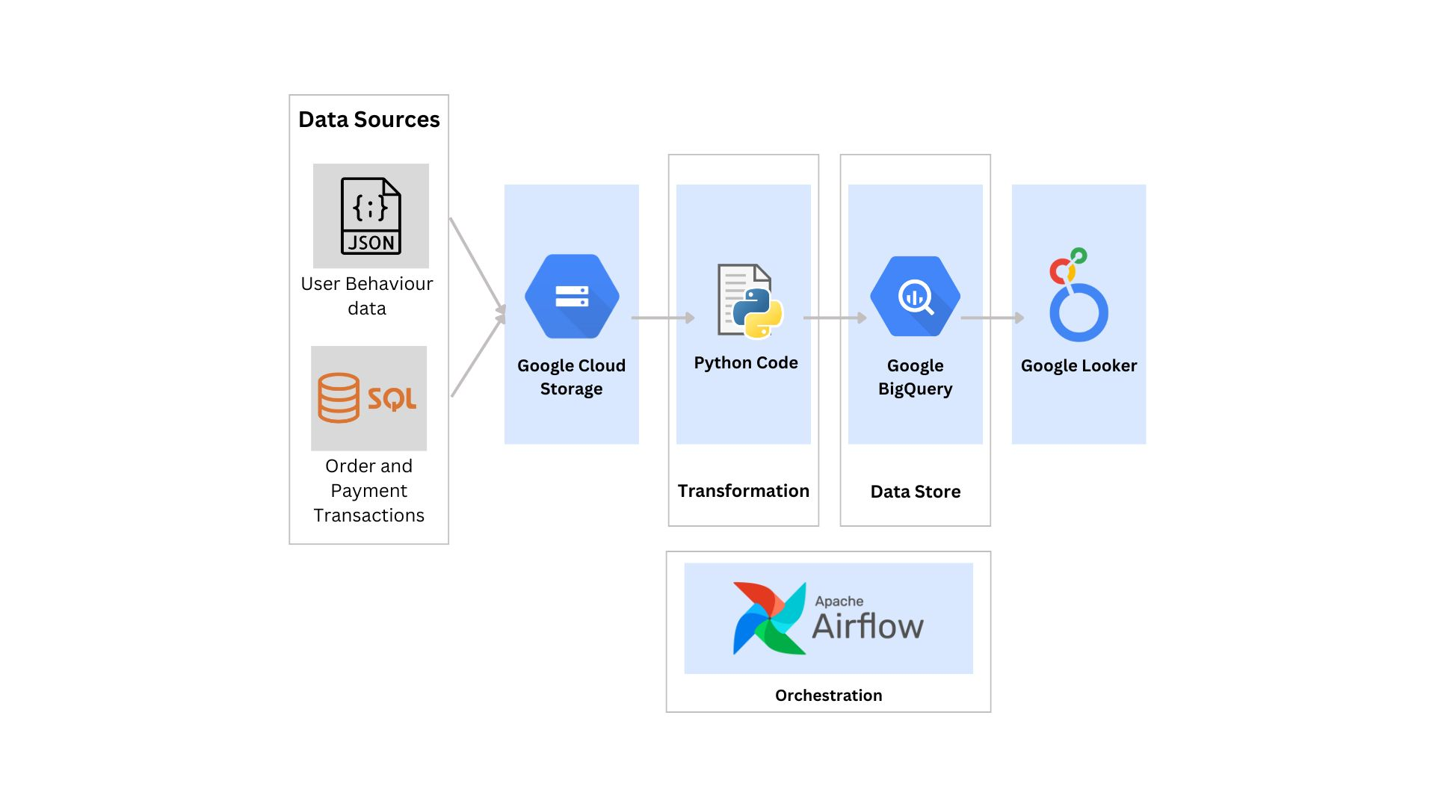
Notes:
This would be the flow of the pipeline.
*CLICK*
Our data pipeline begins with the integration of diverse data sources. We receive user behavior data encapsulated in JSON files, providing valuable insights into user interactions on the website. The second data source comprises of customer orders and payment transactions extracted from SQL and stored in CSV files. The reason for using CSV files was due to data privacy concerns. Hence, we are not able to connect to SQL directly.
*CLICK*
The initial step involves storing these data in Google Cloud Storage.
*CLICK*
The raw data would then be subjected to a transformation process using python code. This step is crucial for refining and structuring the data to meet our specific analytical requirements. This step includes mapping and joining the data from the two sources and data cleaning.
*CLICK*
Once the data has been transformed and cleansed, it is loaded to Google BigQuery, a data warehouse. Google BigQuery helps in storing and querying large datasets.
*CLICK*
To unlock the insights derived from the data, we will utilise Google Looker, a data visualization tool. Looker connects directly to BigQuery, enabling our team to create insightful dashboards and reports for Sicpama.
*CLICK*
To automate and schedule the entire data pipeline workflow, we will use Apache Airflow. This service allows us to schedule, and monitor workflows, ensuring that data are regularly updated in Google BigQuery.
*CLICK*

Slide 15




Comparison
Initial Idea
Implementation
Google Cloud Dataflow for transformation
Google Cloud Composer for automation and scheduling of data pipeline
Cons
Costly to set up
Difficult to implement
Python for transformation
Apache Airflow for automation and scheduling of data pipeline
Pros
Free
Our team has experience in the usage of Airflow
Notes:
Initially, we had chosen to use Google Cloud dataflow for the transformation process and Google cloud composer for the automation and scheduling of the data pipeline. However, through our testings, we have found some cons of utilising these tools. The first being Google cloud composer being costly to set up and the second is dataflow is difficult to implement.
Hence, in our implementation, we have used python for the transformation and Apache Airflow to automate and schedule the data pipeline. The reasons for choosing these applications are because it's free and our team has experience in the usage of airflow.
Now I’ll pass the time to Wei Han who would share with you more on our dashboard

Slide 16
Dashboard
Notes:
Thank you Victoria. Now, I will proceed to give an overview of the dashboard we have created.

Slide 17


Overview
User Behaviour
Order Process
CSS Path
Notes:
We have used Google Looker to create our dashboard as it allows for interactive and dynamic visualizations, while also allowing for seamless integration with Google Cloud Platform. Our dashboard will consist of 4 pages, mainly the report overview page, user hevaiour page, order process page and CSS Path page.

Slide 18
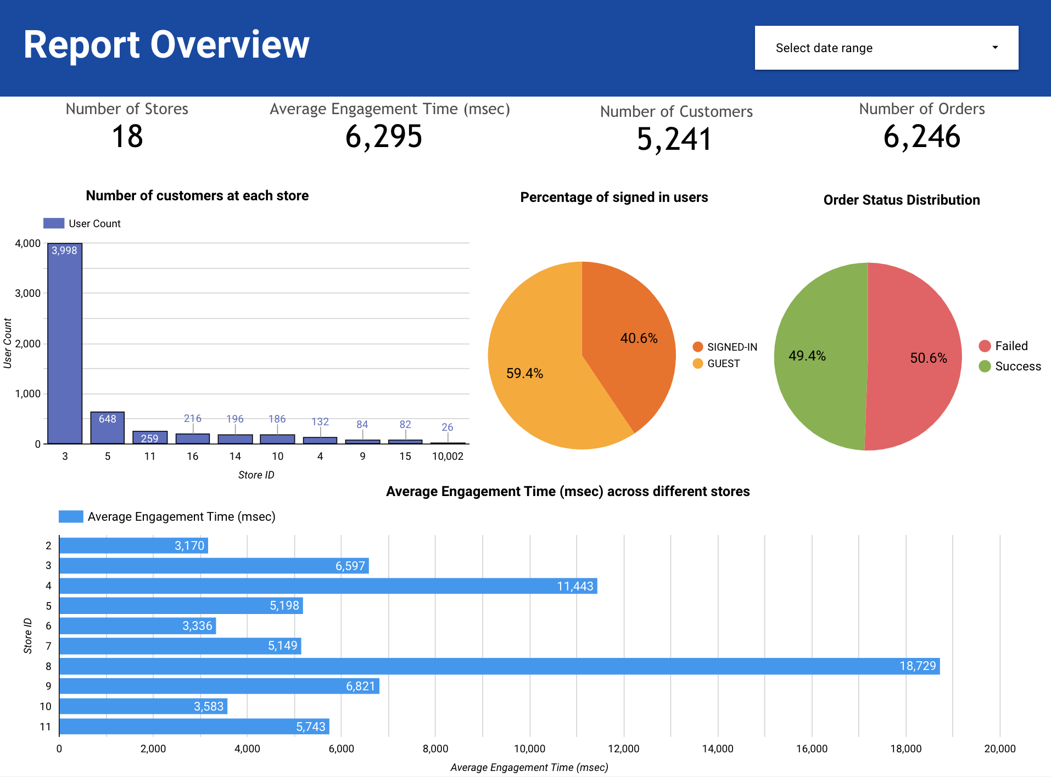
Overview
Overview of general information
Percentage of signed in users
Customers at each store
Average engagement time across each store
Notes:
Firstly, for the report overview page, it shows an overview of general information such as the percentage of signed in users, number of customers in each store and the average engagement time across different stores.

Slide 19
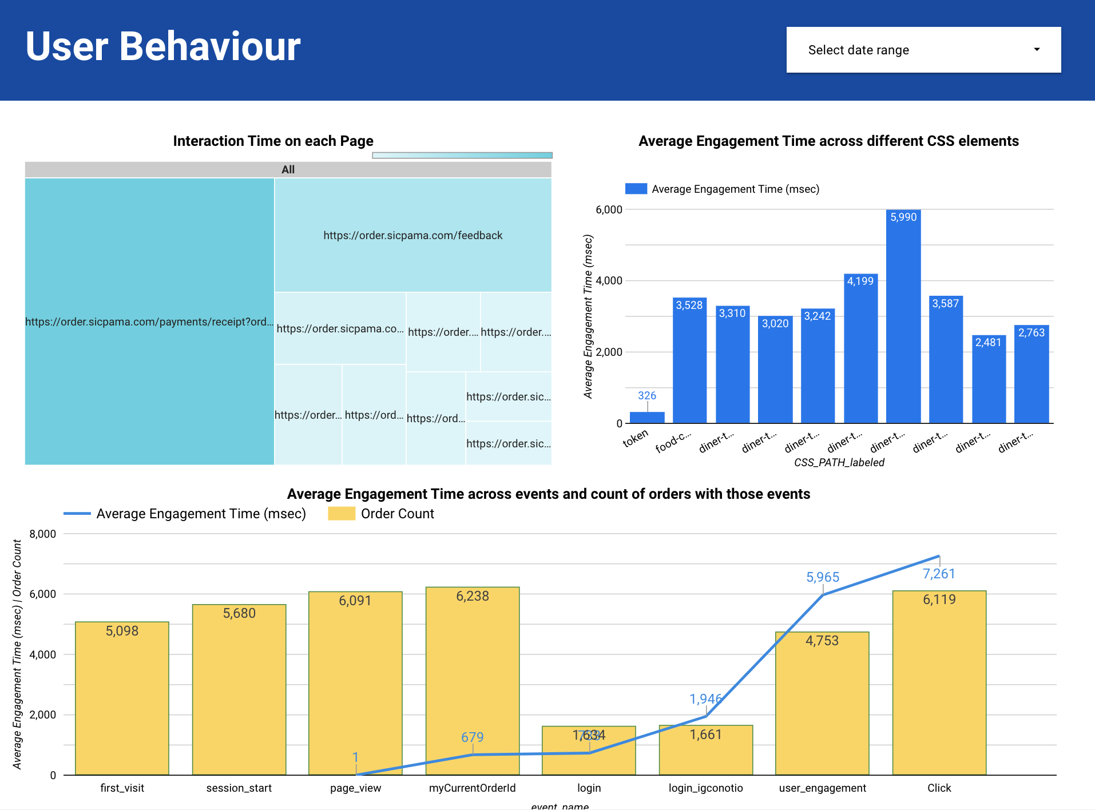
User Behaviour
Information about user behavioural patterns
Interaction Time on each page
Average engagement time across different styling elements
Notes:
Next, the user behavior page. This page gives information about the user behavioural patterns, such as the interaction time on each page, and the engagement time across different styling elements.

Slide 20
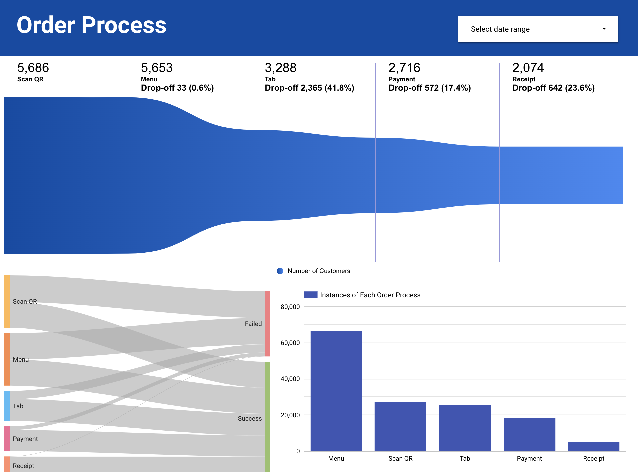
Order Process
Information about drop outs at each stage of the order processes
How many users succeed or fail in each of the respective order processes such as Scan QR.
Notes:
Next, the order process page. His page shows information about drop outs at each stage of the order process, such as how many users succeed or fail in each of the respective order processes like Scan QR.

Slide 21
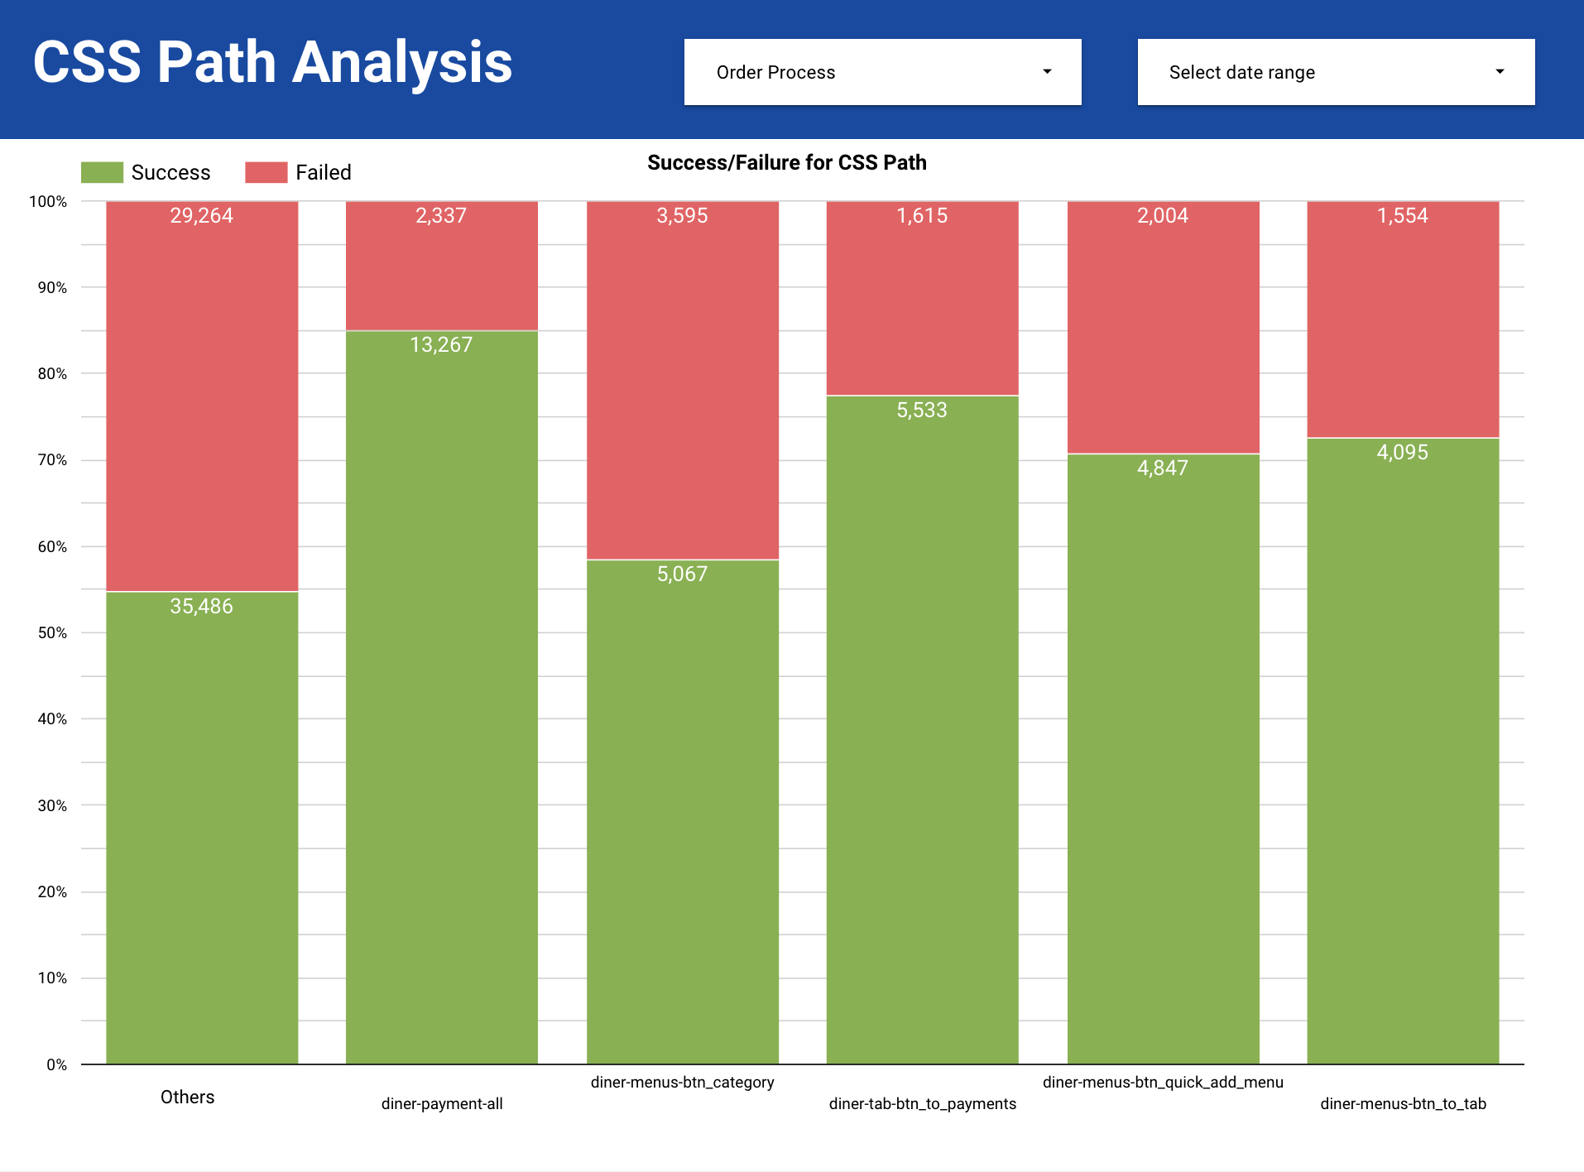
CSS Path
Specific CSS Path information
Number of successful and failed orders associated with each CSS Path
Notes:
Last but not least, we have the CSS Path page. This page shows specific CSS Path information, such as the number of successful and failed orders associated with each CSS Path. Next, I will now pass on the time to James who will give a demonstration of the pipeline.

Slide 22
Pipeline Demonstration

Slide 23
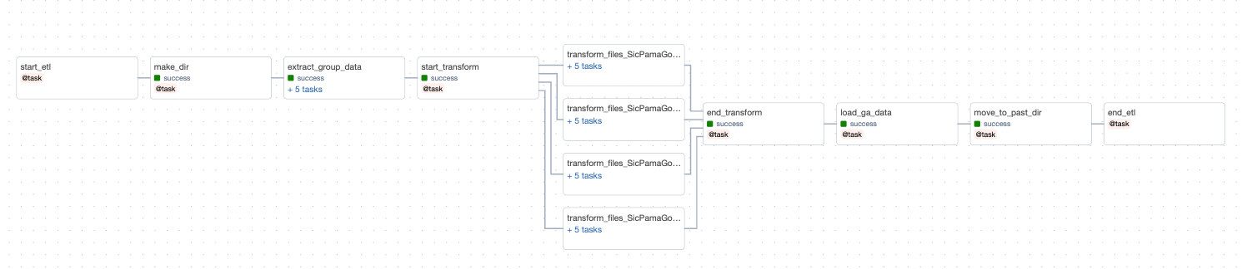
Pipeline Airflow Structure
Extraction from gcs
Concurrent Transformation
Loading into BigQuery and Cleanup

Slide 24


Slide 25
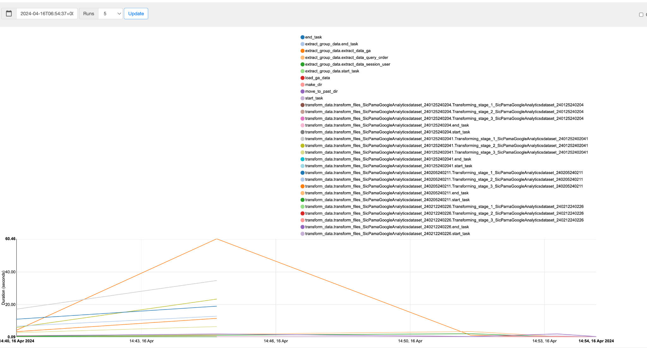
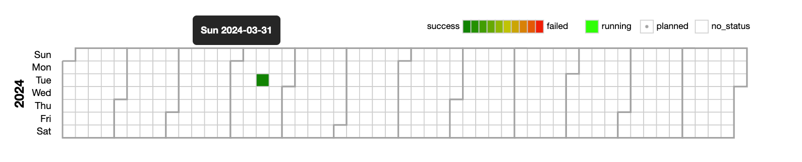
Continuous Monitoring Workflow

Slide 26
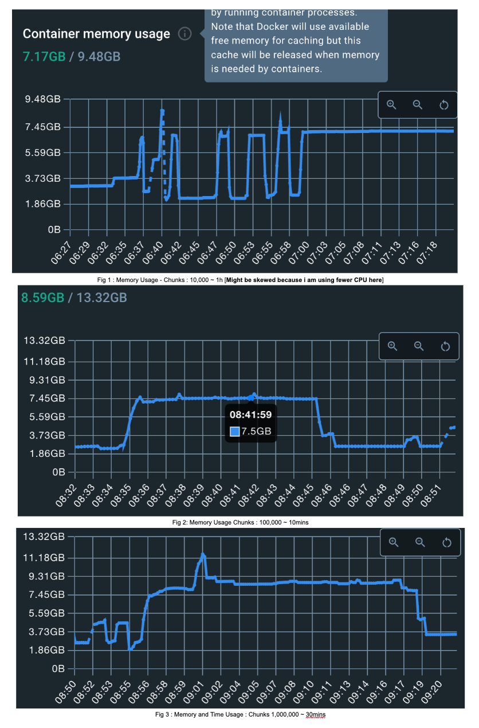
Resources Monitoring
Performance Testing On Time Taken
Best : 100,000 chunks @ < 10mins
Performance Testing On Memory Required
Best : 100,000 chunks @ < 8gb

Slide 27
Dashboard Demonstration

Slide 28
Recommendation for Sicpama
Connect SQL to Data pipeline
Connect GA data directly
Notes:
ue to privacy issues we aren't able to have access to the SQL Data that SicPama is using in their database, therefore they can connect their sql data directly into the database. With our pipeline now, SicPa can also opt to connect Google Analytics data instead of uploading into the Google Cloud storage.

Slide 29
Achievements
✔️ Hypothesis
✔️ Data Pipeline
✔️ Dashboard
Notes:
So in conclusion, what we achieve at the end of this project is helping SicPam derive better insights from their data through a dashboard with a robust data pipeline architecture and at the same time providing them with actionable hypotheses and recommendations through our initial exploratory analysis stages.

Slide 30
Thank You

